Slide 1

Housing : Price Predictions
Submitted by:
PRIYAL AGARWAL

Slide 2
Project Introduction : Housing :Price Predictions
A US-based housing company named Surprise Housing has decided to enter the Australian market. The company uses data analytics to purchase houses at a price below their actual values and flip them at a higher price.
For the same purpose, the company has collected a data set from the sale of houses in Australia.
The company is looking at prospective properties to buy houses to enter the market.
Building a model using Machine Learning in order to predict the actual value of the prospective properties and decide whether to invest in them or not. For this company wants to know:
Which variables are important to predict the price of variable?
How do these variables describe the price of the house?

Slide 3

Problem Statement
Build a model to predict the price of houses with the available independent variables. This model will then be used by the management to understand how exactly the prices vary with the variables. They can accordingly manipulate the strategy of the firm and concentrate on areas that will yield high returns. Further, the model will be a good way for the management to understand the pricing dynamics of a new market.
House Price Predictions

Slide 4


Mathematical/ Analytical Modelling of the Problem
In the provided dataset, our target variable “SalePrice" is a numerical feature. Therefore, we will be handling this modelling problem as regression.
Data Source :The sample data is provided from FlipRobo’s client database.

Slide 5




Exploratory Data Analysis Steps
Data Features Check
Null Value Check
Correlation Check
Statistics Check
Extract feature information about dataset such as number of rows ,columns and data types of the different features.
In this dataset, we have 1460 rows with 81 features.
Check for the null values present in our dataset via heatmap.
Null values are present in our dataset.
Imputing it by filling mean, median and mode accordingly.
Then using visualization checked the correlation of features with each other and output features.
Few columns were highly correlated with each other ~90%.
This part tells about the statistics i.e. mean, median, max value ,min values ,75% and it also gives some sort of outliers’ analysis .
Few outliers were present in the data.

Slide 6



Data Preprocessing Steps
Data Cleaning/Dropping
Checking Data-Skewness
Removing Outliers
Now we dropped some features which are less important or not affecting the outcome variable
For further processing, also dropped some less important features that has values which might not be realistic.
Now, we checked for the distribution of data with the help of hist plot ,whether it is left skewed or right skewed
Observed that many features are right skewed , so further treated it via box-cox transform method.
Checking for outliers by considering threshold value=3.
Observed that we cannot remove all the outliers because more than 20% of data is removed using this method.

Slide 7
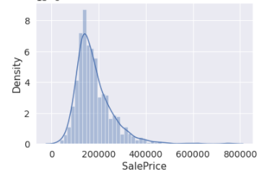
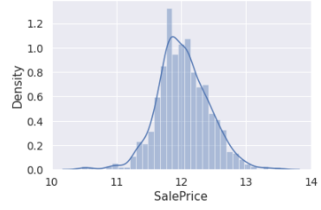
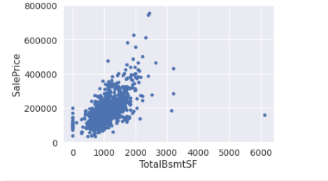
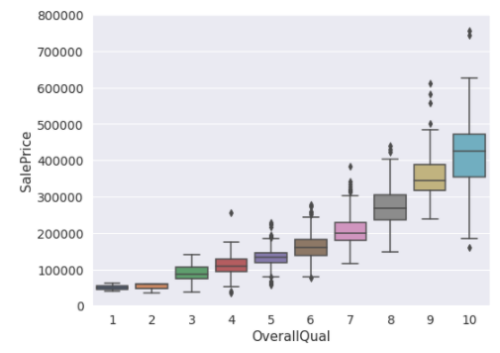
Visualization
We see the target variable(SalePrice) before and after log transform with the help of distplot.
Then we visualize by plotting different variables with our target variable(SalePrice) to understand the relationship between different features.
Bi-Variate Analysis(Numerical Feature)
Bi-Variate Analysis(Categorical Feature)

Slide 8
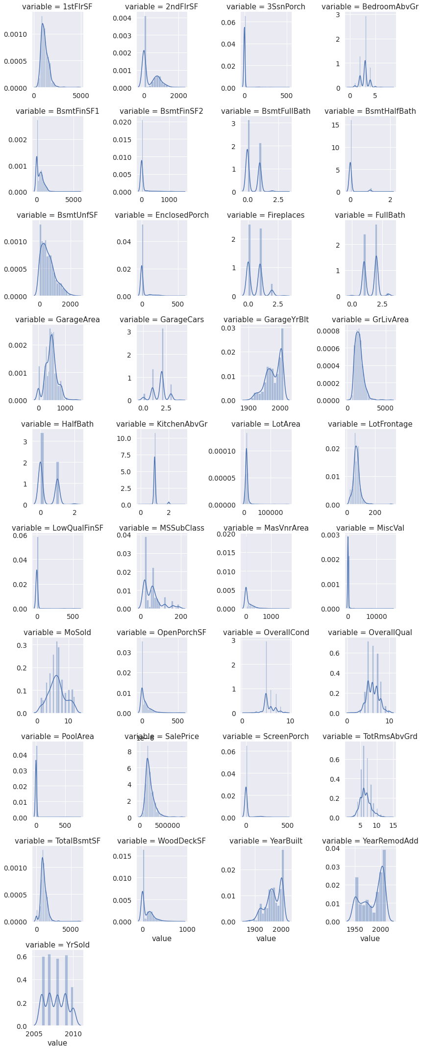
Visualization
DIST PLOT For Data Distribution
We plotted distplot for more information regarding to all numerical features.

Slide 9
Modeling Parts
We know that this is Regression Problem so we use R2 score, Mean_squared_error, Mean_absolute_error and RMSE for evaluation of final model.
We will also see the R2 score and also plot the scatter plot to see our prediction results of our final model.
Imbalanced dataset is normalized for final modeling.
After splitting the data for input and output Standard-Scalar is applied to standardize the input data.
After train test split applied all the regression algorithms with hyper tuning to find the best scoring one.

Slide 10
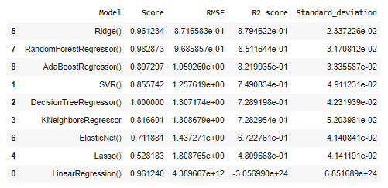
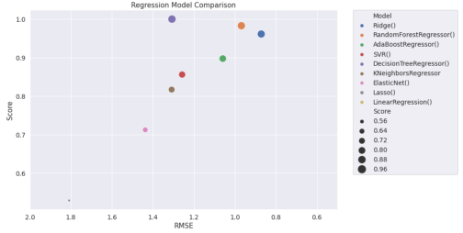
Finalized Model
After applying all the above regression algorithms on the dataset, we see that Ridge Regressor has maximum R2 score and less RMSE as compared to other models.
Before selecting final model, cross validation done to avoid under fitting and over fitting of the model.
Ridge Regressor is selected as final model
Compared predicted vs test result using scatter plot and found close relation between predicted and test values.
Saved final model as joblib pickl file.
Model Summary
RMSE vs Score

Slide 11
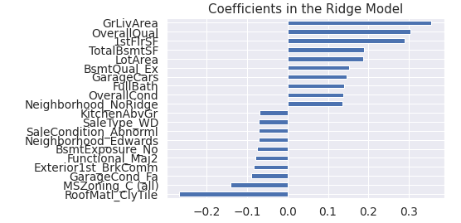
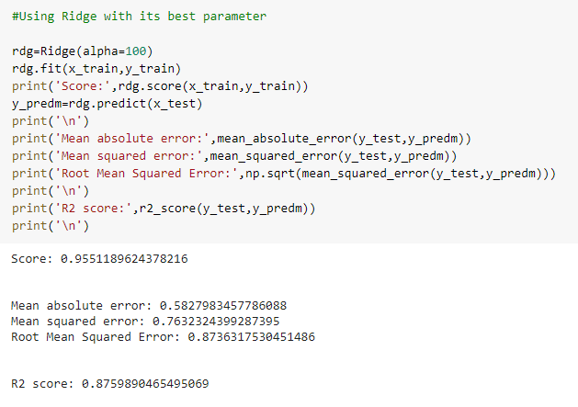
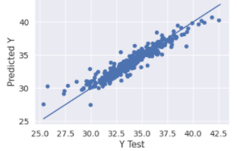
Finalized Model
Plotting important coefficients
Final Model – Regression Report
Test results vs Predicted Values

Slide 12
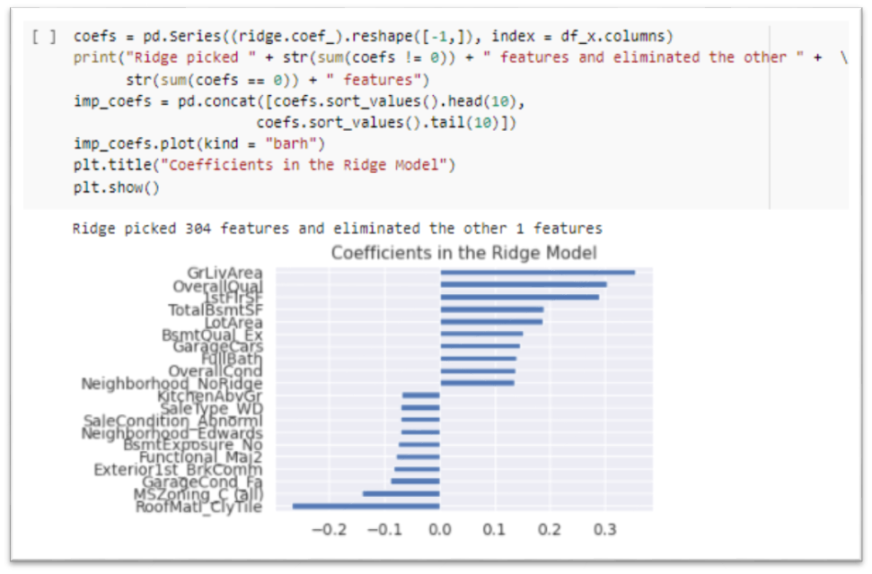
Important Variables affecting Sale Price
Which variables are important to predict the price of variable?
How do these variables describe the price of the house?
Highly Affecting Variable
Low Affecting Variable
Total Basement Area
Lot Area , Basement Quality
Garage Cars , Full Bath, Neighborhood
Ground Living Area
Ground Living Area
Overall Quality
1st floor Area
1st Floor Area
Full Bath, Garage
Sale Price
Overall Quality
Basement , Lot
Neighborhood

Slide 13
Conclusion
Taken output variable as ‘SalePrice‘.
Found best model as Ridge Regressor which provides lowest RMSE score of 0.873.
Fine tuning done on the model and found best parameters (alpha=100) for the prediction.
Plotted Regression curve(scatter plot) and found linear line that shows close match between test and predicted values.
Also plotted distplot that shows normal distribution of the predicted values.
Overall model fit is good.
By removing some more outliers, present in dataset the results might improve.

